Slide 1
Introduction to Data Science with Python
Chapter 4

Slide 2
Topics of the course
2. Chapter
3. Chapter
4. Chapter
Python Fundamentals
Data Wrangling & Simple visualizations
Visualizations & Modelling
Basic concepts, Variables, basic data structures, functions
How to process data with pandas and visualize it with matplotlib
More plots with matplotlib and seaborn and an introduction to modelling

Slide 3
Advanced Visualisations & Modelling
Clean Data with Pandas

Slide 4

Clean data
Data comes often in an untidy form, therefore some data cleaning is necessary
Name | Town
Clara | Frankfurt a.M.
Sarah | Frankfurt am Main
John | Berlin
df1['Town'] = df1['Town'].str.replace(
'a.M.','am Main')

Slide 5
Clean data
Data comes often in an untidy form, therefore some data cleaning is necessary
Name | Subject
Clara | Physics
Sarah | physics
John | Math
df[’Subject’] = df[’Subject’].str.lower()

Slide 6
Fill missing values
Name | Score
Clara | 10
Sarah | 5
John | NaN
df['Score'] = df['Score'].fillna(0)

Slide 7
Fill missing values
Name | Score
Clara | 10
Sarah | 5
John | NaN → 0
df['Score'] = df['Score'].fillna(0)
Notes:
fillna - Often in machine Learning used

Slide 8
Fill missing values
Name | Score
Clara | 10
Sarah | 5
John | NaN → 7.5
df['Score'] = df['Score'].fillna(df.mean())

Slide 9
Drop missing values
Name | Score
Clara | 10
Sarah | 5
John | NaN
df = df.dropna()

Slide 10
Working with dates

Slide 11

What kind of data type is this : "27-03-2021" ?
integer b) float c) string d) date

Slide 12
Transform string to datetime object
df[’Birthday’] = pd.to_datetime(df[’Birthday’])
Name | Birthday
Clara | “10/10/1995”
Sarah | “01/10/1999”
John | “03/05/2001”

Slide 13
Transform string to datetime object
df[’Birthday’] = pd.to_datetime(df[’Birthday’], format=”%d/%m/%Y”)
Name | Birthday
Clara | “10/10/1995”
Sarah | “01/10/1999”
John | “03/05/2001”

Slide 14
Transform string to datetime object
df[’Birthday’] = pd.to_datetime(df[’Birthday’], format=”%m-%d-%Y”)
Name | Birthday
Clara | “10-10-1995”
Sarah | “10-01-1999”
John | “05-03-2001”

Slide 15
Transform string to datetime object
df['day'] = df['Birthday'].dt.day
df['weekday'] = df['Birthday'].dt.weekday
df['month'] = df['Birthday'].dt.month
Name | Birthday | day | weekday | month
Clara | “10-10-1995” | 10 | 1 | 10
Sarah | “10-01-1999” | 1 | 4 | 10
John | “05-03-2001” | 3 | 3 | 5
Notes:
Once changed to datetime you can do fancy stuff like this

Slide 16
Set date as index
date | City | Temperature
“2021-04-20” | ‘Frankfurt’ | 10
“2021-04-21” | ‘Frankfurt’ | 11
“2021-04-22” | ‘Frankfurt’ | 12
df = df.set_index(['date'])

Slide 17
Select timespans
When the index is in datetime format, you can access the data in the following way:
date | City | Temperature
“2021-04-20” | ‘Frankfurt’ | 10
“2021-04-21” | ‘Frankfurt’ | 11
“2021-04-22” | ‘Frankfurt’ | 12
df['2021'] # all data from 2021
df['2021-04':'2021-05'] df['2021':]

Slide 18
Exercise 1
df['date'] = pd.to_datetime(df['date'])
df = df.set_index(['date'])
df['2021-04':'2021-05']
df[df[‘col_name’] == ‘some condition’]
plt.plot(df[‘col_name’][‘2000’])

Slide 19
pandas has a lot of useful functionality
The official documentation of pandas has more than 3000 pages
work with missing values
fill with mean value
interpolate between values
fill with last value
Read data from various sources
Excel, CSV, SQL, Stata, SPSS, SAS, HTML Tables from websites
Windowing functions
Moving average,...
Notes:
We gave you a rough idea what pandas can do but it is way more powerful, if you dive in deeper.

Slide 20
Advanced Visualisations & Modelling
Advanced Visualizations with Seaborn

Slide 21

library
statistical data visualization tools
based on matplotlib
makes it easy to create more sophisticated plots
best to visualize relations between columns of a dataset
import seaborn as sns

Slide 22
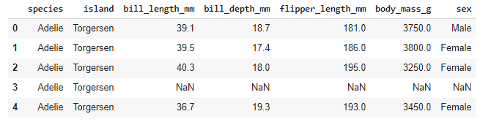
Look into a penguins dataset

Slide 23
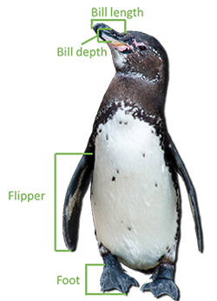
Look into a penguins dataset
Source: https://www.galapagos.org/blog/the-measure-of-a-penguin/

Slide 24
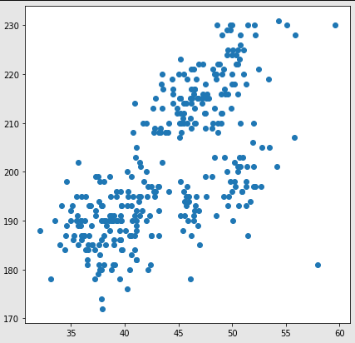
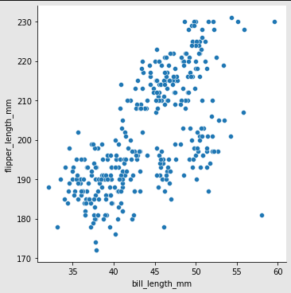
Matplotlib vs Seaborn
plt.scatter(df['bill_length_mm'],df['flipper_length_mm'])
sns.relplot(df['bill_length_mm'],df['flipper_length_mm'])
Notes:
Same code length, quite similar
Result in seaborn already has named axis

Slide 25
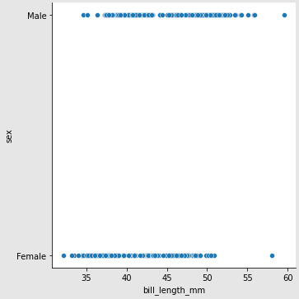
Matplotlib vs Seaborn
plt.scatter(df['bill_length_mm'],df[sex])
sns.relplot(df['bill_length_mm'],df[sex])
TypeError
Notes:
Seaborn can plot Strings on Floats
Matplotlib fails here (you’d have to transform the Strings Female and Male to a binary scale like 0 and 1)

Slide 26
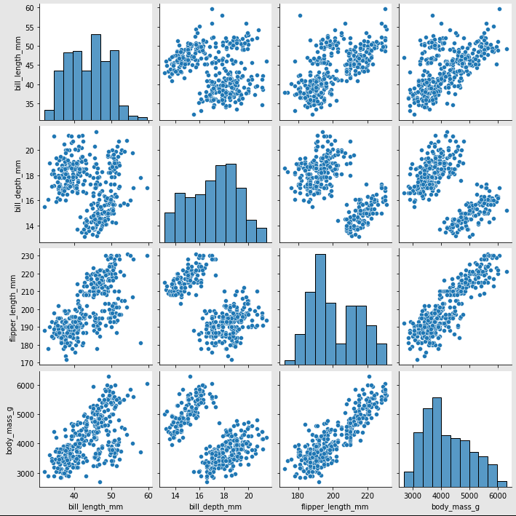
Pairplot
sns.pairplot(df)
Notes:
Plot pairwise relationships in a dataset
The diagonal plots are treated differently: a univariate distribution plot is drawn

Slide 27
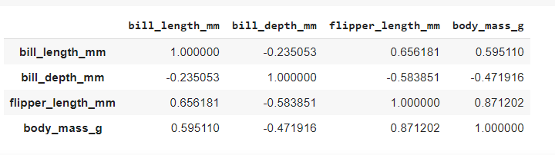
Visualize correlations
df.corr()
Notes:
Fast way to get correlations between columns/features

Slide 28
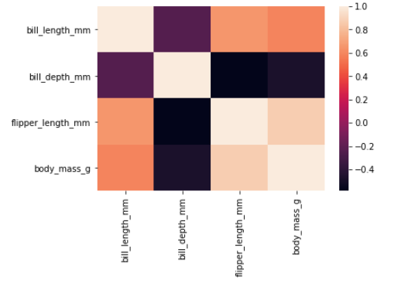
Visualize correlations
sns.heatmap(df.corr())
Notes:
Based on that we can visualize the correlations

Slide 29
Exercise 2
sns.pairplot(df)
sns.pairplot(df, hue=’col_name’)

Slide 30
Matplotlib & Seaborn Gallery
Documentation contains example plots
Each plot comes with the corresponding code
https://matplotlib.org/stable/gallery/index.html
https://seaborn.pydata.org/examples/index.html

Slide 31
Advanced Visualisations & Modelling
Modelling Basics

Slide 32

Linear Regression
How expensive is this house?
Based on information like:
amount of rooms
location
size
Source: https://avantecture.com/p/phoenixsee/

Slide 33
Housing regression
Old collected data
New data
House | Location | Rooms | Price
A | Berlin | 6 | 500k €
B | Frankfurt | 8 | 600k €
C | Berlin | 7 | 300k €
House | Location | Rooms | Price
D | Frankfurt | 8 | ?
E | Frankfurt | 5 | ?
F | Berlin | 4 | ?

Slide 34
Housing regression
Old collected data
New data
House | Location | Rooms | Price
A | Berlin | 6 | 500k €
B | Frankfurt | 8 | 600k €
C | Berlin | 7 | 300k €
House | Location | Rooms | Price
D | Frankfurt | 8 | ?
E | Frankfurt | 5 | ?
F | Berlin | 4 | ?
Features

Slide 35
Housing regression
Old collected data
New data
House | Location | Rooms | Price
A | Berlin | 6 | 500k €
B | Frankfurt | 8 | 600k €
C | Berlin | 7 | 300k €
House | Location | Rooms | Price
D | Frankfurt | 8 | ?
E | Frankfurt | 5 | ?
F | Berlin | 4 | ?
Features
Target column

Slide 36
Linear Regression
1M €
800 k €
600 k €
400 k €
200 k €
1 2 3 4 5 6 7
Amount of rooms

Slide 37

Linear Regression
1M €
800 k €
600 k €
400 k €
200 k €
1 2 3 4 5 6 7
Amount of rooms

Slide 38

Linear Regression
1M €
800 k €
600 k €
400 k €
200 k €
RMSE =
1 2 3 4 5 6 7
Amount of rooms

Slide 39
Linear Regression
House | Bedrooms | Rooms | Price
A | 1 | 6 | 500k €
B | 3 | 8 | 600k €
C | 2 | 7 | 300k €

Slide 40
How good is your model?
How does the model perform on unseen data?
Split data in a train (70%) and test (30%) set to evaluate your model
data
test data
train data

Slide 41
Typical workflow
data
test data
model
train data
train model

Slide 42
Typical workflow
data
test data
model
train data
train model

Slide 43
Typical workflow
data
test data
model
train data
train model

Slide 44
Linear Regression with Python
import pandas as pd # data
from sklearn.model_selection import train_test_split # split data
from sklearn.linear_model import LinearRegression # create model
from sklearn.metrics import mean_squared_error # test model

Slide 45
Linear Regression with Python
import pandas as pd
from sklearn.model_selection import train_test_split
from sklearn.linear_model import LinearRegression
from sklearn.metrics import mean_squared_error
df = pd.read_csv('/content/housing.csv')
X = df[['total_rooms','households']]
y_target = df['median_house_value']

Slide 46
Linear Regression with Python
import pandas as pd
from sklearn.model_selection import train_test_split
from sklearn.linear_model import LinearRegression
from sklearn.metrics import mean_squared_error
df = pd.read_csv('/content/housing.csv')
X = df[['total_rooms','households']]
y_target = df['median_house_value']
X_train, X_test, y_train, y_test = train_test_split(X, y_target, test_size=0.3)
model = LinearRegression()
model.fit(X_train, y_train)

Slide 47
Linear Regression with Python
import pandas as pd
from sklearn.model_selection import train_test_split
from sklearn.linear_model import LinearRegression
from sklearn.metrics import mean_squared_error
df = pd.read_csv('/content/housing.csv')
X = df[['total_rooms','households']]
y_target = df['median_house_value']
X_train, X_test, y_train, y_test = train_test_split(X, y_target, test_size=0.3)
model = LinearRegression()
model.fit(X_train, y_train)
y_predict = model.predict(X_test)
rmse = mean_squared_error(y_test, y_predict, squared=False)

Slide 48
Exercise 3

Slide 49
Linear Regression with Python
from sklearn.metrics import mean_squared_error
from sklearn.metrics import r2_score
from sklearn.metrics import median_absolute_error
rmse = mean_squared_error(y_test, y_predict, squared=False)
r2 = r2_score(y_test, y_predict)
mae = median_absolute_error(y_test, y_predict)

Slide 50

Deep Learning

Slide 51

Deep Learning with Tensorflow
import tensorflow as tf
X = tf.constant([1,2,3,4,5,6,7])
y = tf.constant([2,3,4,5,6,7,8])
X_new = tf.constant([8])
model = tf.keras.models.Sequential([
tf.keras.layers.Dense(4, activation="relu", input_shape=[1,]),
tf.keras.layers.Dense(4, activation="relu"),
tf.keras.layers.Dense(1 , activation="relu")])
model.compile(loss="mse", optimizer="adam")
model.fit(X,y, epochs=10)
model.predict(X_new)

Slide 52
Advanced Visualisations & Modelling
Python Local Installation

Slide 53

Code Execution
Download Python: https://www.python.org/
Running
Code
my_code.py
python interpreter

Slide 54
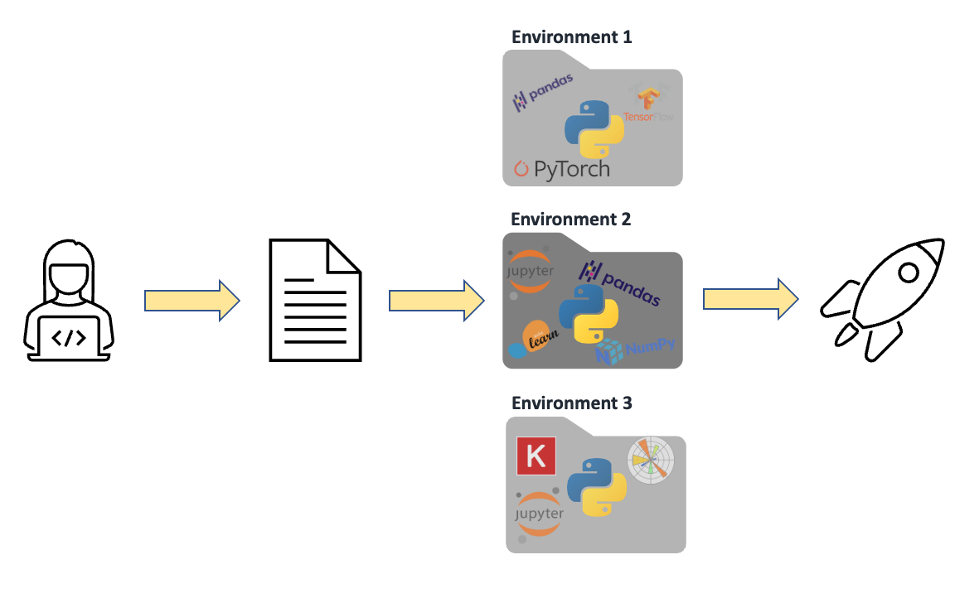
Environments
To install packages for a particular project
Dependencies are installed in different directories
Running
Code
my_code.py

Slide 55

Anaconda distribution
Python interpreter
Jupyter Notebooks (similar to Colab, but local)
Manage environments and packages
Runs on Windows, Mac and Linux
Installation:
https://docs.anaconda.com/anaconda/install/
Getting started:
https://docs.anaconda.com/anaconda/user-guide/getting-started/

Slide 56

Pycharm
Python IDE
Free Educational License for Pro Version
Many Alternatives: VS Code, Atom, …
Installation:
https://www.jetbrains.com/community/education/#students

